Slide 1
Essential libraries for ml& dl& cv
NumPy & matplotlib & SciPy & pandas

Slide 2
NumPy
It’s the main library in python that deals with scientific computing, it provides high performance multi-dimensional array
So mainly it deals with arrays and metrices

Slide 3
1. How to create an array
First: import the library
np.array which takes the numbers
Ex: np.array([1,2,3,4])

Slide 4
Getting the shape and type
Arrays can be one dimensional or multidimensional so in order to know that to know that you have to get the shape
Array. Shape
Type(array)
This is for getting the type of an array

Slide 5
Change the values in the array
Ex: array = np.array([1,2,3,4])
The index of the values starts from the zeroth element
In order to access number 3 for example, then it is located at index 2
To change it: array[2] = 7
The new array now is [1,2,7,4]

Slide 6
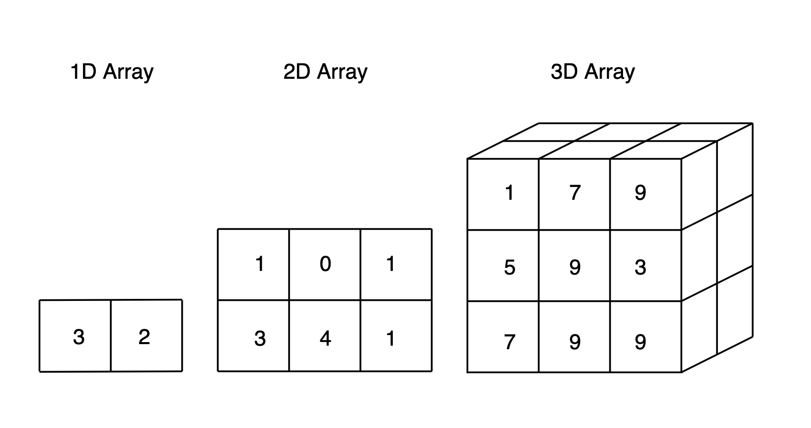
Multi dimensional array

Slide 7
Multi dimensional array means that it has more than one row and Colum
To create it: np.array([ [10,20,30,40], [50,60,70,80] ])
Now it is a 2d array
To get the shape: array. Shape
(2, 4) which means 2 rows and 4 columns

Slide 8
Indexing and slicing
Ex: array = np.array([[1,2,3], [7,8,9], [3,5,7]])
For slicing: array[rows , columns] so
array[0:2 , 1:3] ??
Note: the first one is included, the second is excluded

Slide 9
Creating automatic arrays
1. zeros array
2. ones array
3. identity array
4. constant array
5. random array

Slide 10
Zeros & ones & constant
Zeros: np.zeros((shape of the array))
Ones: np.ones((shape of the array))
Constant number: np.full((shape of the array), (the number) )

Slide 11
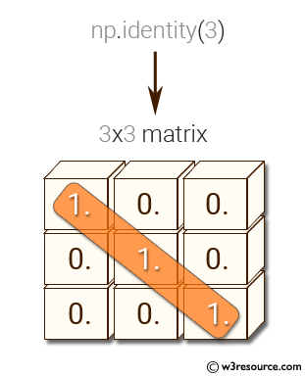
Identity Metrix
To create it: np.eye(the number of ones)

Slide 12
Random Metrix
The most important one for machine and deep learning.
np.random.random((shape of the array))
The numbers are randomly chosen and is between 0 and 1
Used for initializing the weights in ml & dl

Slide 13
Argmax
Argmax is a method that brings you the index of the highest values
Ex: arr = np.array([0.2, 0.4, 0.8])
print(np.argmax (arr) ) index 2 is the output
Note: this function is used mostly in deep learning (activation function outputs)

Slide 14
Arithmetic operations
Np.add (x, y) where x and y are arrays
Np.subtract (x, y)
Np.multiply (x, y)
Np.divide (x, y)
Np.sqrt (x)
Np.sin (x)
Np.cos (x)

Slide 15
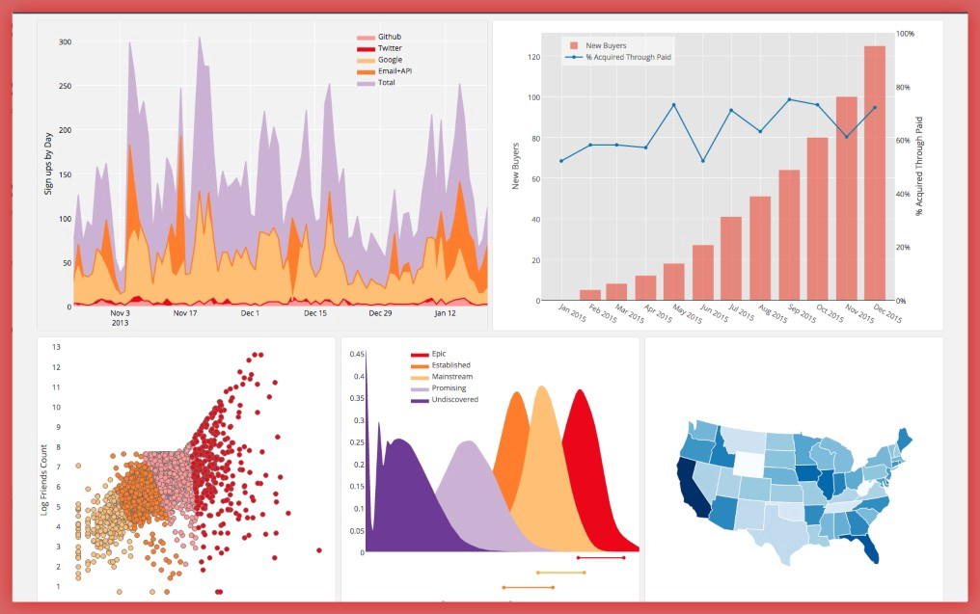
2. matplotlib
Used for data visualization and plotting graphs

Slide 16
Steps for data visualization
1. create the data (array of x & array of y)
2. plot the graph
3. give title
4. label the axis
5. name each plot
6. show the graph

Slide 17
Methods of matplotlib
1. plt.plot
2. plt.scatter
3. plt.title
4. plt.legend
5. plt.xlable
6. plt.ylable
7. plt.subplot
8. plt.show

Slide 18
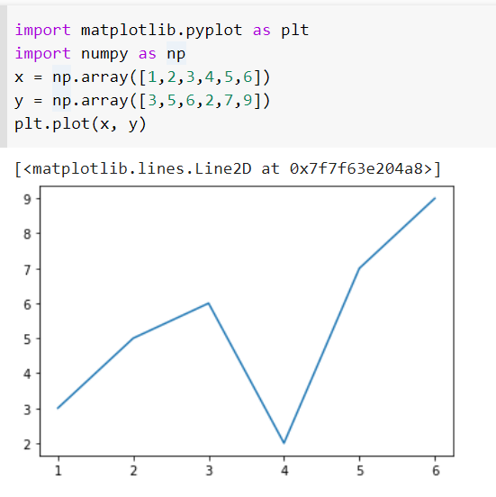
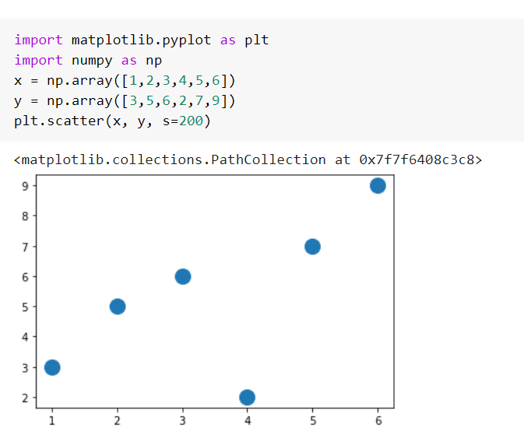
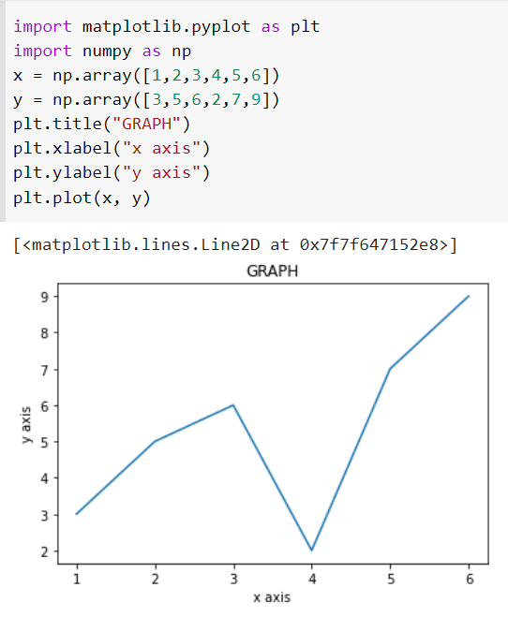
PLOT & SCATTER & TITLE

Slide 19
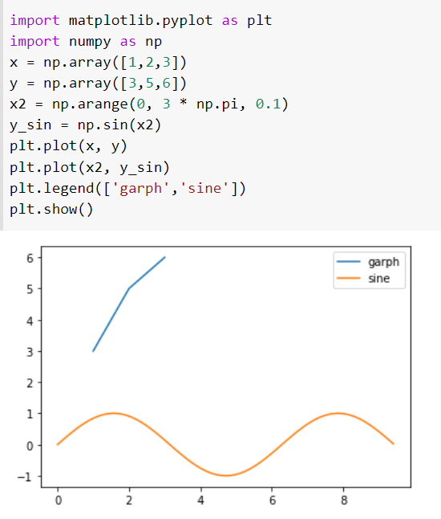
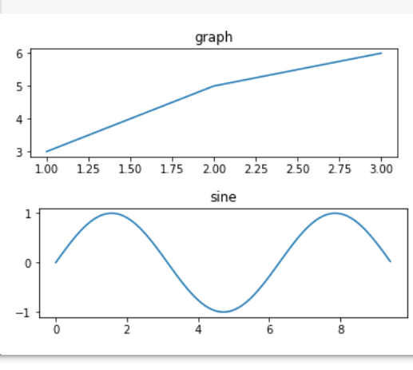
Legends & subplot

Slide 20
subplots
import matplotlib.pyplot as plt import numpy as np x = np.linspace(1, 10, 20) y = np.linspace(2, 30, 20) z = np.array([1,3,4,2,2,2,2,2,5,6,7,8,9,0,9,9,8,7,8,7]) fig, ((ax1, ax2), (ax3, ax4)) = plt.subplots(2, 2, figsize=(15,15)) ax1.plot(x, y, color = 'r') ax2.plot(x, z) ax4.plot(x, y) ax3.plot(x, z) plt.show()

Slide 21
3. pandas
Excel sheet for python.
The most essential library for ml because it is where the data gets pre processed.
Clean the data by doing things like removing missing values and filtering rows or columns by some criteria.

Slide 22
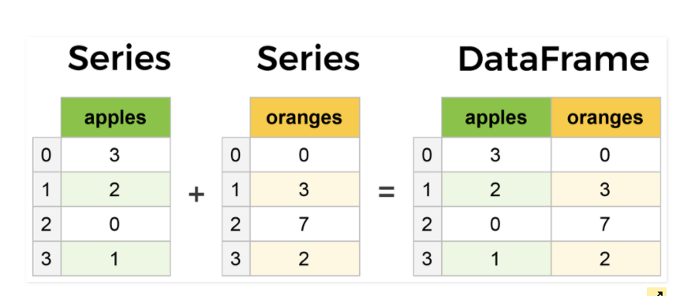
Primary Components of pandas
1. Series
2. Data frame

Slide 23
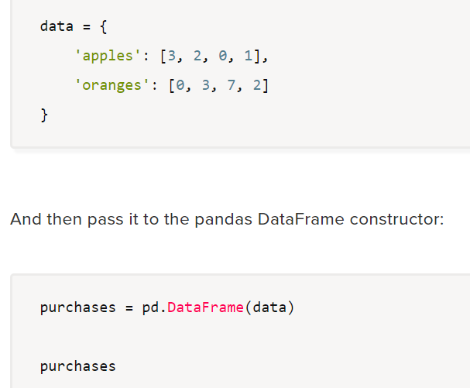
Creating data frame from scratch

Slide 24
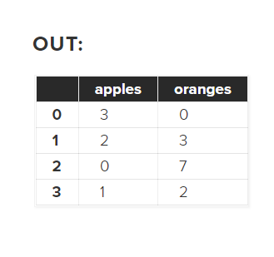
output

Slide 25
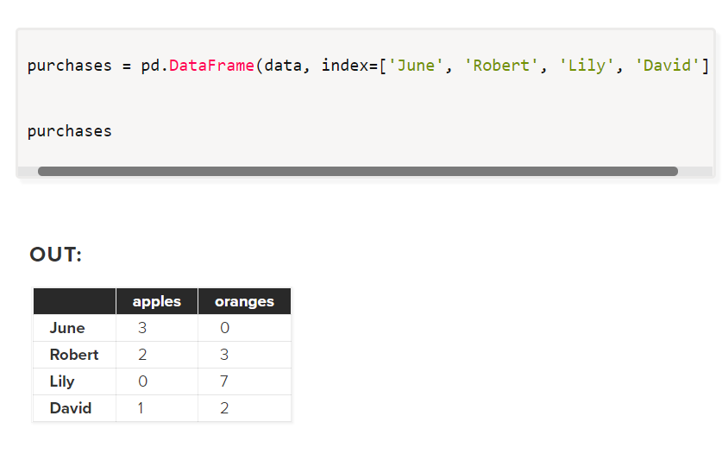
Index of the data frame
The Index of this Data Frame was given to us on creation as the numbers 0-3, but we could also create our own when we initialize the Data Frame.

Slide 26
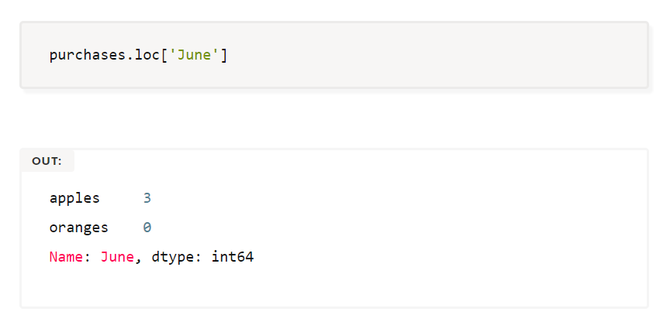
Access a specific index

Slide 27
Reading files with pandas
Here comes the most important part in pandas
60% of The data which we are going to use through out the course are coming from an excel sheet
So in order to read it use the method pd.readcsv(‘path’)

Slide 28
Convert the data frame to an array
Dataframe.values

